Slide 1

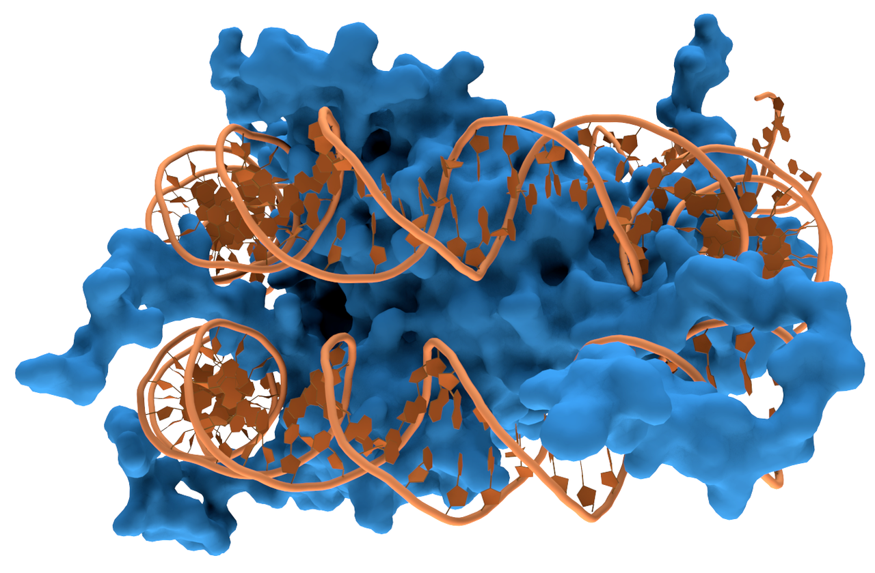

Overall Study Design
Understanding regulatory landscapes in immune cell differentiation and immune diseases
Identify cell type-specific TFs
Taiji-reprogram: Predict candidate TFs in exhausted T cell rejuvenation
DNA-protein interaction prediction based on DNA and protein sequences
B
γδT
Act T
T_{EX}Ter
T_{RM}
scTaiji: fit Taiji to single-cell data in pre-RA samples
DNA representation
protein
representation
stem
αβT
Mo
NK
Bulk data
Single-cell data
MF/GN
Deep learning models
DC
experimental validation
Taiji-community: construct TF-TF interaction network
WT control
LCMV infection
D7, 20+ post-infection analysis
DPI
KO shRNA
TF-regulatee
TF-TF
network
network
Aim1
Aim2
Aim3

Slide 2
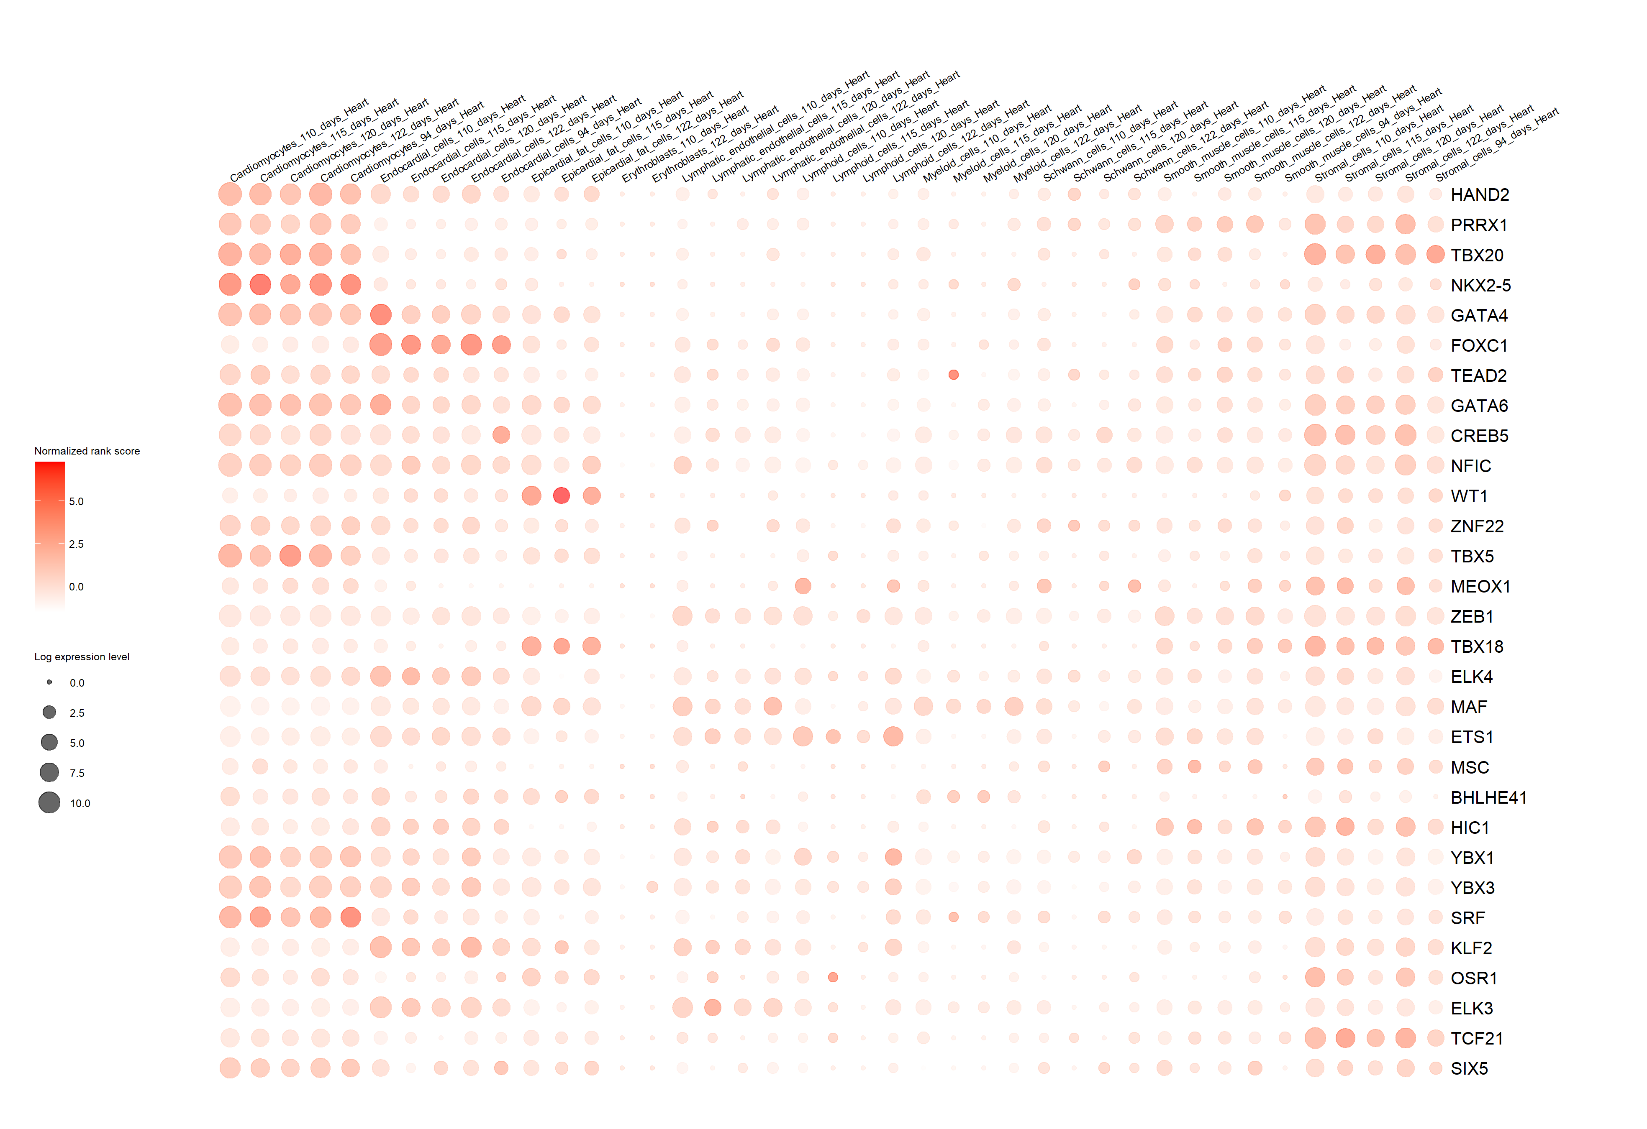
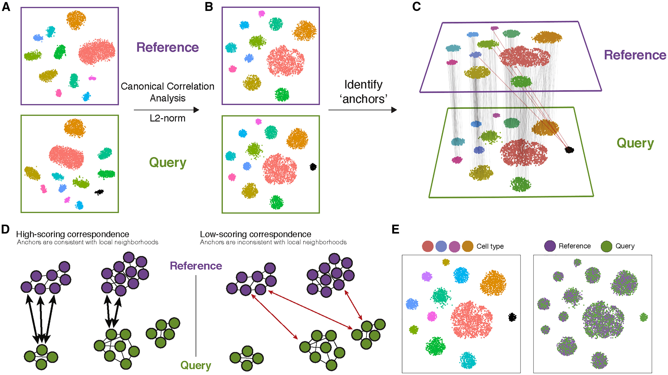
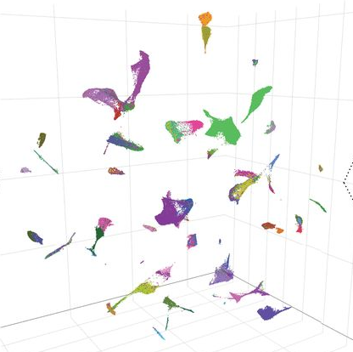
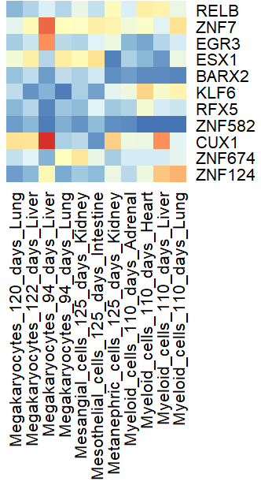
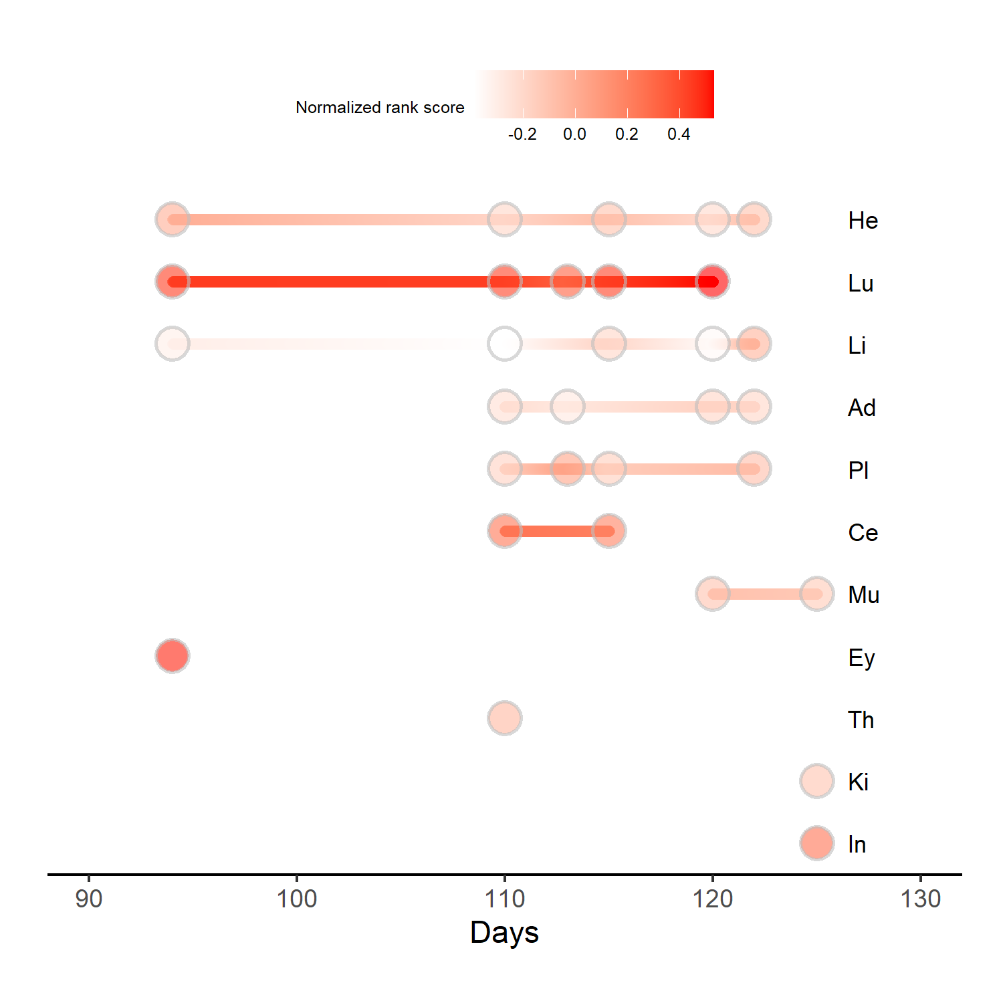
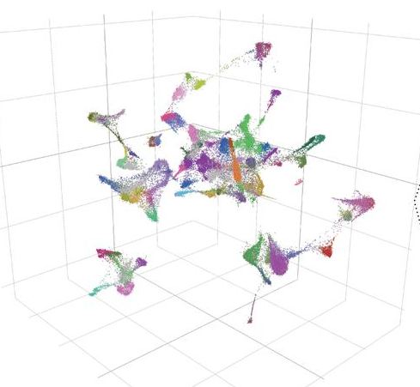
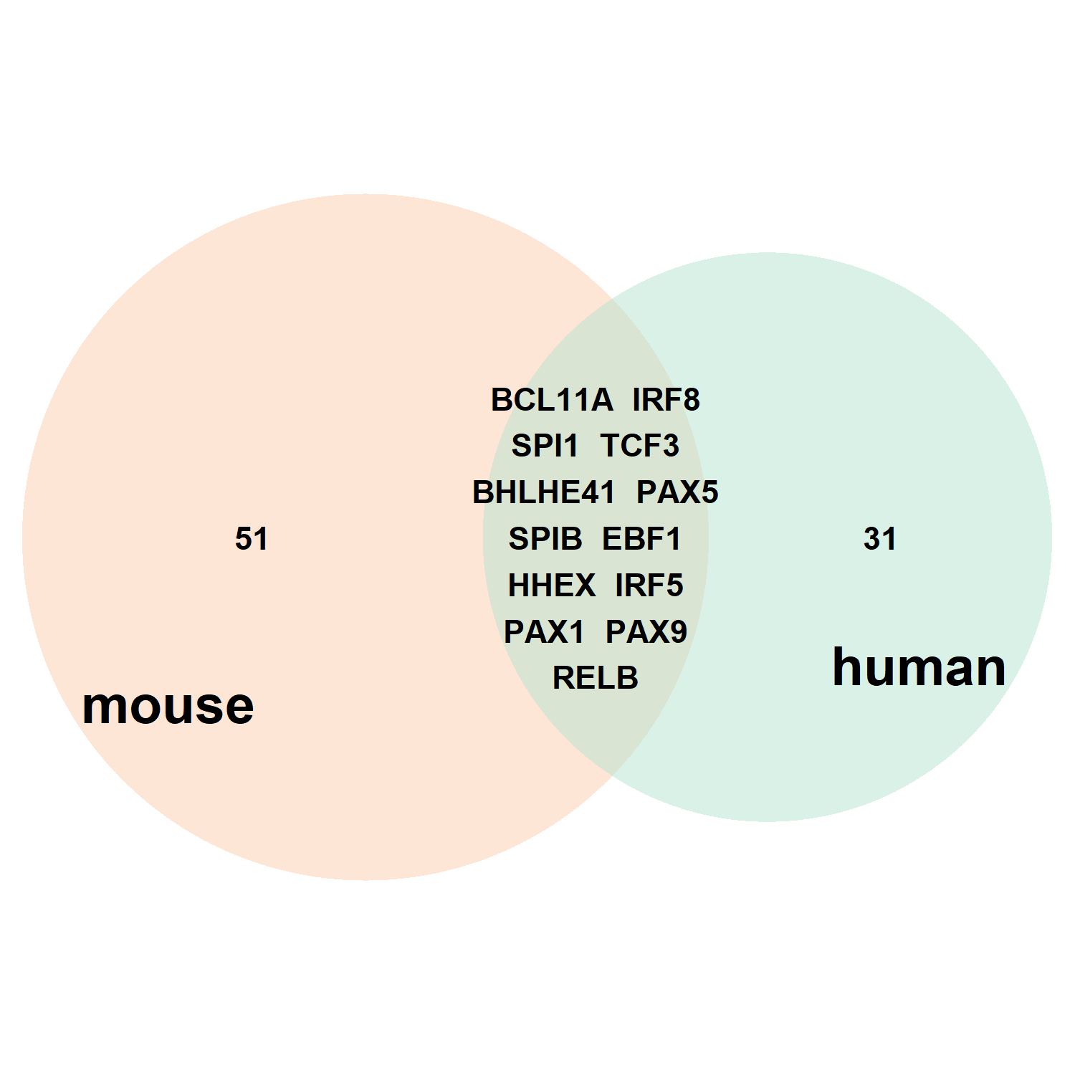
Seurat
Taiji
Downstream analysis
Co-embedding scRNA-seq and scATAC-seq
Cell-type-specific TFs
Input
Gene expression
Output
scRNA-seq
PageRank score matrix
cardiomyocytes
Chromatin accessibility
Transcriptional waves
Cluster annotation
scATAC-seq
Construct cell-type-specific network
Species comparison
Aggregate gene count and combine peaks within clusters

Slide 3

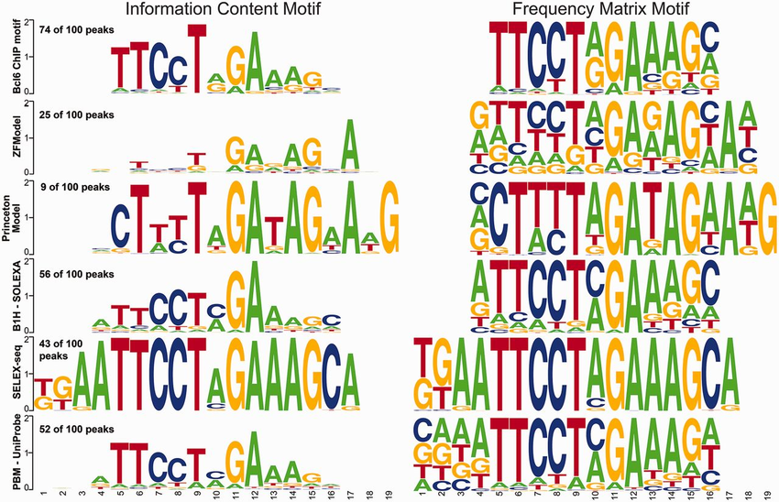
Gene expression
TF1
Gene X
Enhancer
TF1
Gene X
TF2
Gene Y
Promoter
TF2
Gene Y
Assign enhancers and promoters to target genes by Epitensor prediction
Link TFs to target genes
Scan motif binding sites in open chromatin regions
Construct network
PageRank algorithm
Rank websites in Google’s search
Based on number and quality of links to a page
Node weight is gene expression level
Edge weight is regulatory strength
Assign weights by expression and apply personalized PageRank

Slide 4
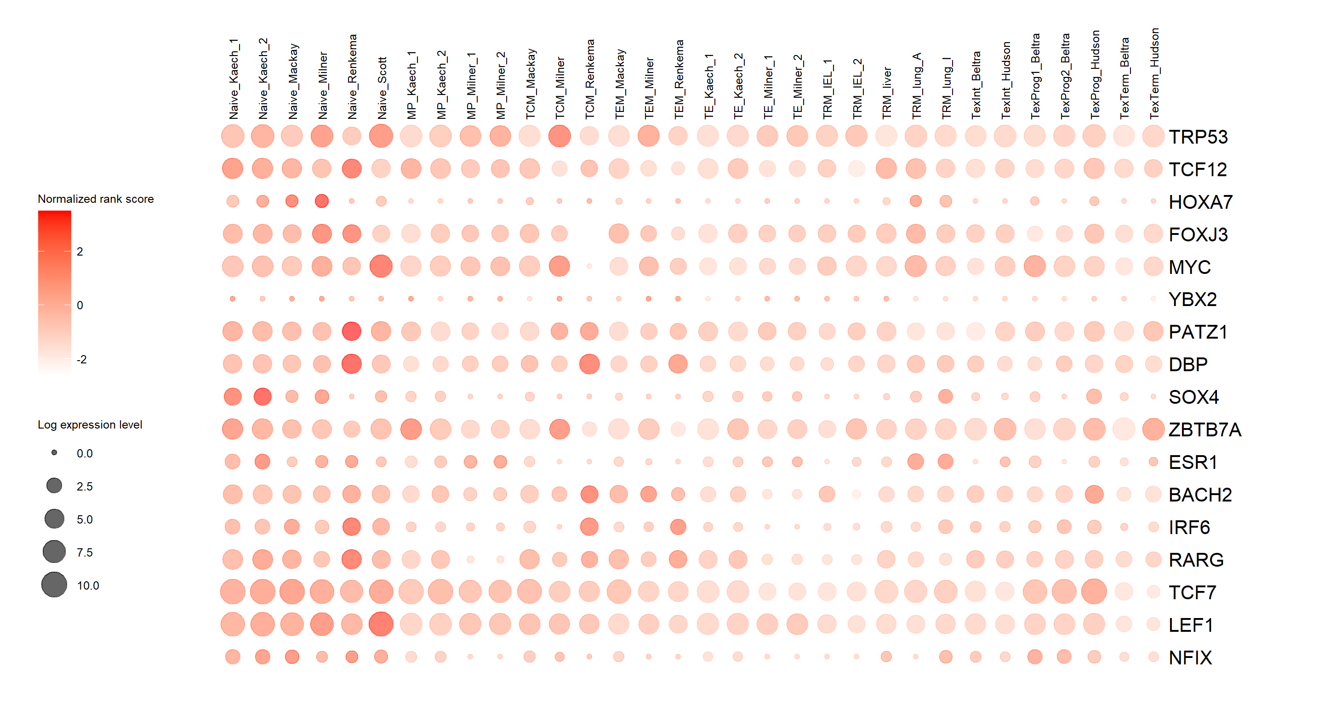
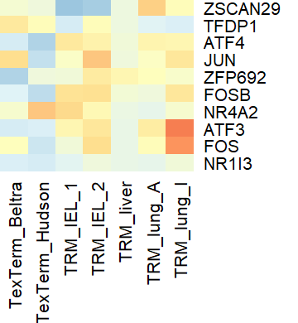
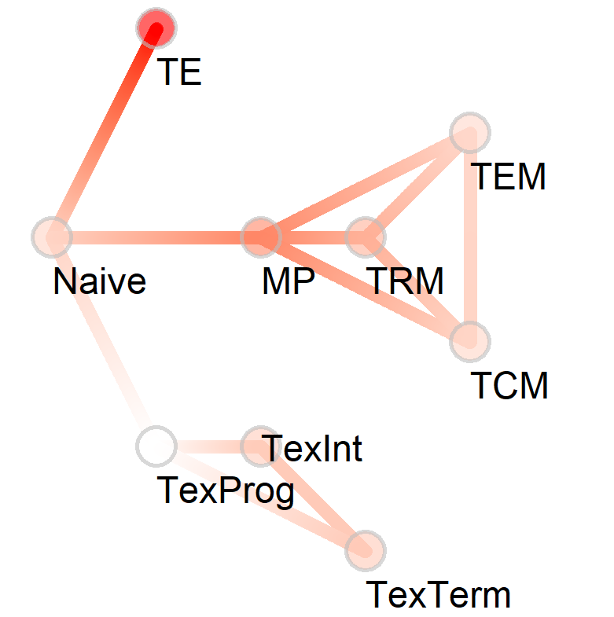
Taiji pipeline
Downstream analysis
Chromatin accessibility
Construct network
Cell-state-specific TFs
Input
Output
Naïve
TexTerm
MP
Scan motif binding sites in open chromatin regions
Tex
Term
Differentiation-specific TFs
TE
N
TCM
TRM
Tex
Prog
CEBPE, ZBTB32, HOXA3, TBX21,
MP
TEM
Tex
Int
TF1
Gene X
Enhancer
N
CEBPE, TBX21, BHLHE40, ZBTB32,
TE
Paired ATAC-seq and RNA-seq of 32 samples across 9 cell types
TF2
Assign weights by expression and apply personalized PageRank
CEBPE, ARID3C, MYBL2, JDP2,
Tex
Prog
Gene Y
Promoter
PageRank score matrix
Assign enhancers and promoters to target genes by Epitensor prediction
Transcriptional waves
Gene expression
TF1
Gene X
TF2
Gene Y
Link TFs to target genes
Notes:
Fig.1 Workflow. The matched RNA-seq and ATAC-seq data were used as input of Taiji to construct a regulatory network and output PageRank scores matrix. The downstream analysis included identification of cell-state-specific TFs, differentiation-specific TFs and construction of temporal transcriptional waves.

Slide 5
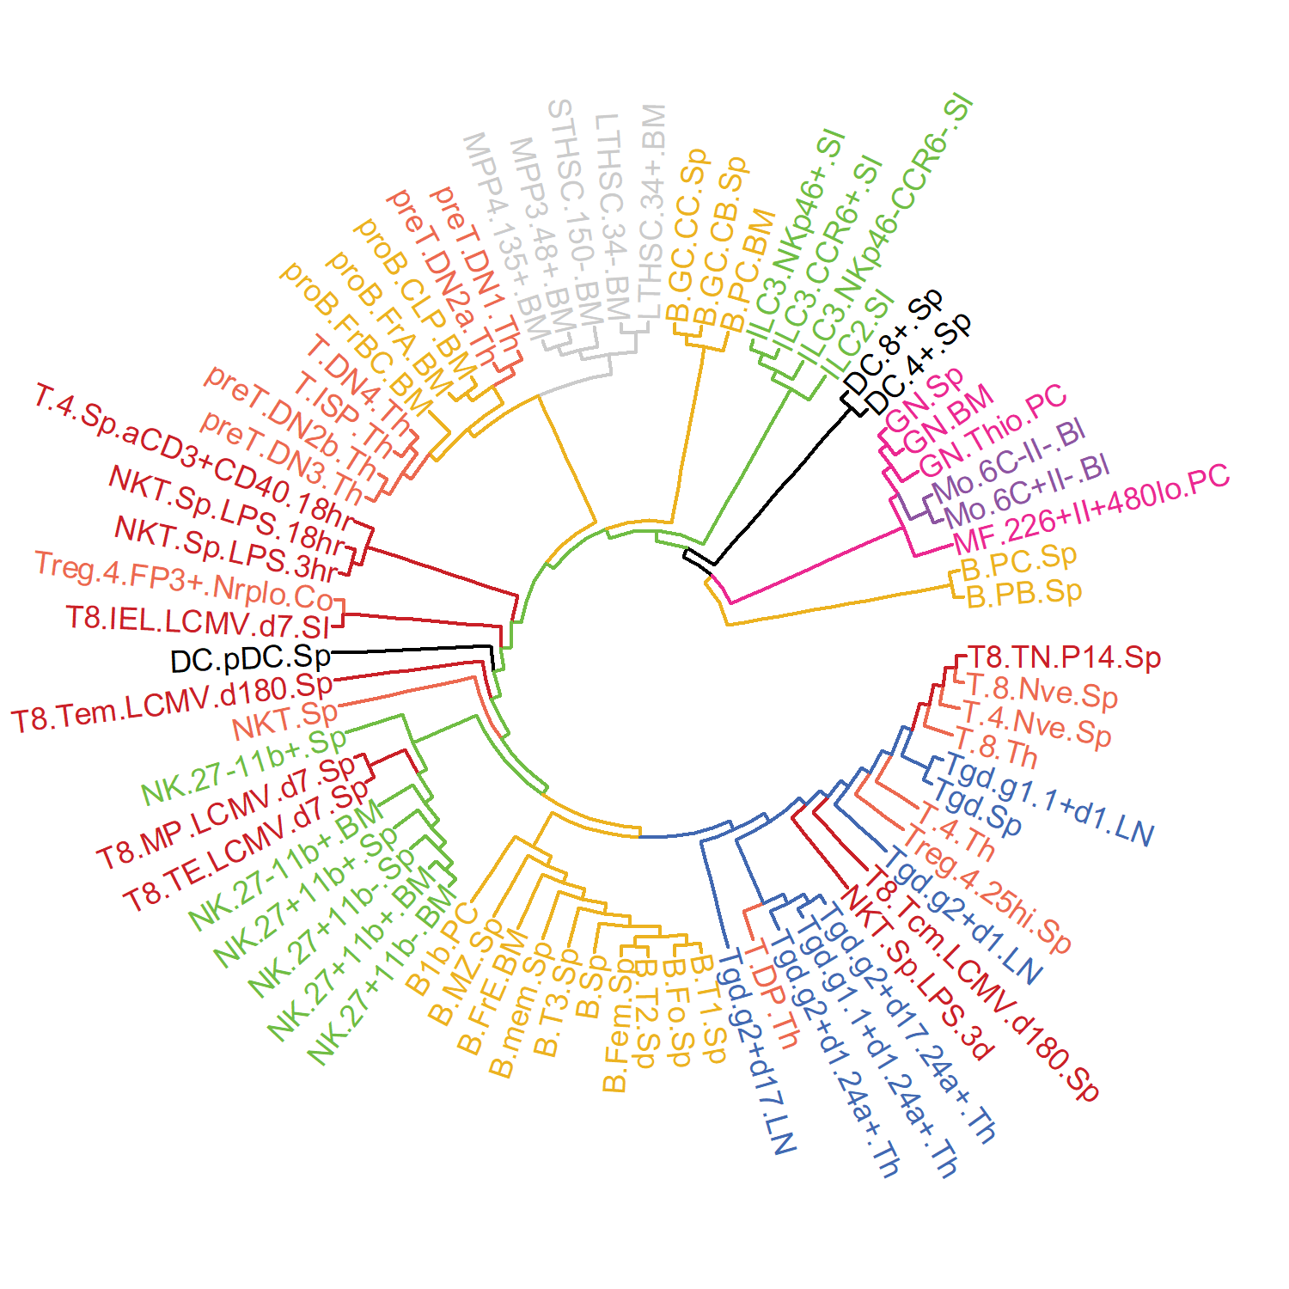

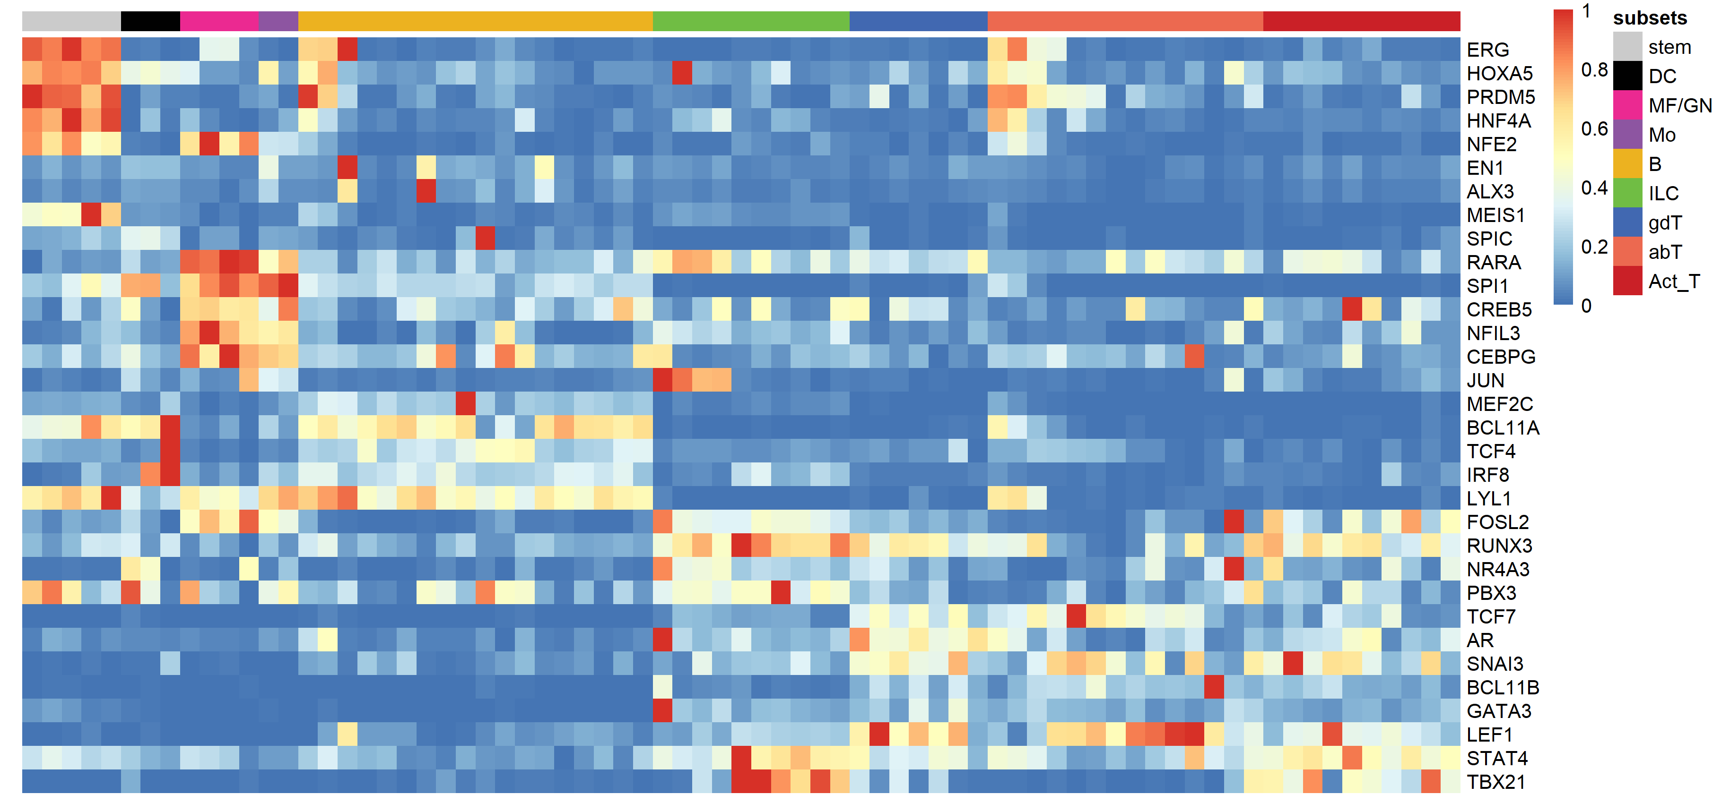
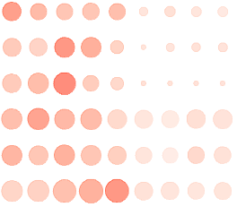

Taiji pipeline
Downstream analysis
Zhang et al., Sci. Adv. (2019)
Chromatin accessibility
Construct network
Clustering
Input
Paired RNA-seq and ATAC-seq
Output
Scan motif binding sites in open chromatin regions
Erg
Hoxa5
Prdm5
Hnf4a
Nfe2
En1
Alx3
Meis1
Spic
Rara
Spi1
Creb5
Nfil3
Cebpg
Cell lineage-specific TFs
Hic1
Ahr
Atf3
Relb
Rbpj
Crem
73 cell types
115 samples
TF1
Gene X
Enhancer
TF2
Gene Y
Assign weights by expression and apply personalized PageRank
Promoter
PageRank score matrix
Transcriptional waves
Assign enhancers and promoters to target genes by Epitensor prediction
B
61 cell types
226 samples
γδT
Gene expression
Act T
TF1
Gene X
stem
αβT
TF2
Gene Y
Mo
NK
MF/GN
Link TFs to target genes
DC
Notes:
Fig.1 Workflow. The matched RNA-seq and ATAC-seq data were used as input of Taiji to construct a regulatory network and output PageRank scores matrix. The downstream analysis included identification of cell-state-specific TFs, differentiation-specific TFs and construction of temporal transcriptional waves.

Slide 6
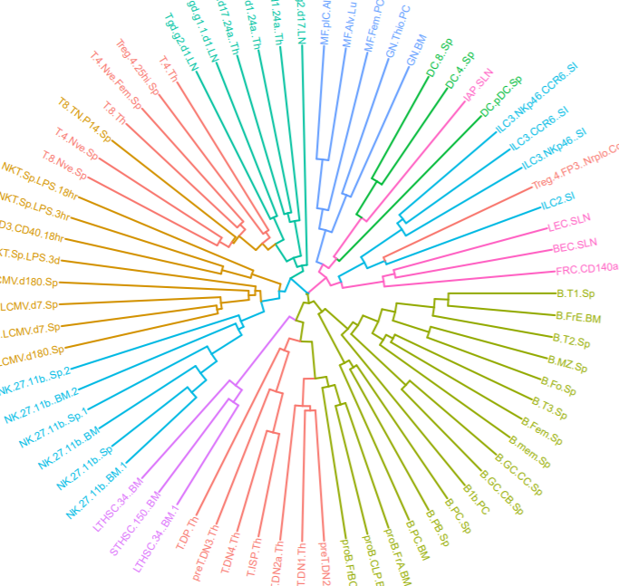
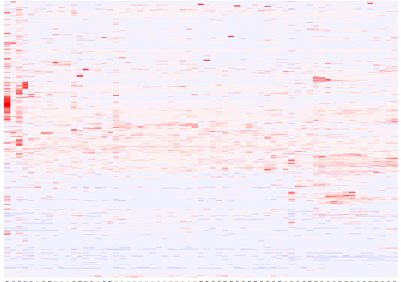
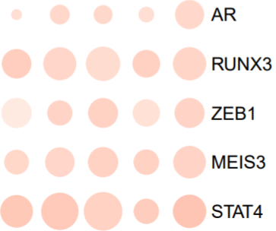
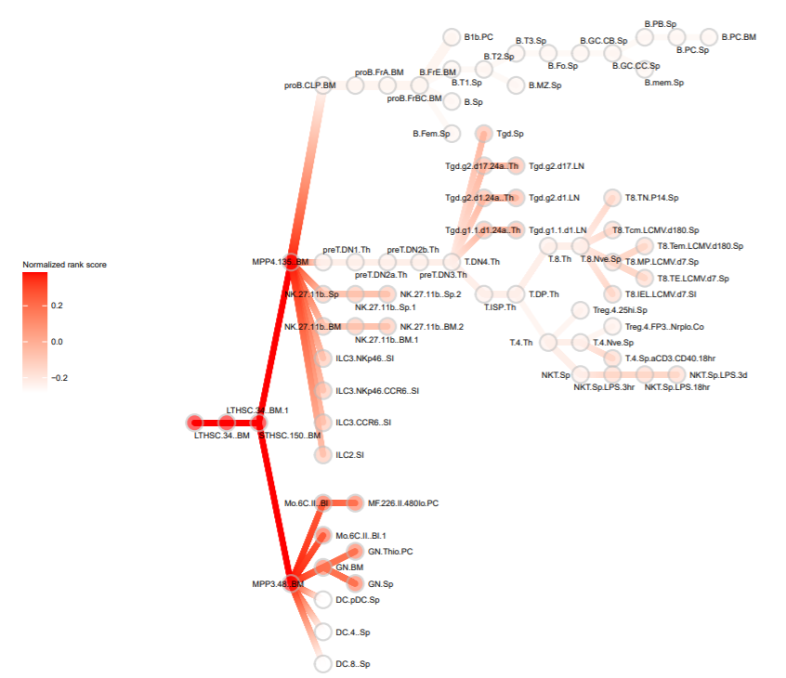
Clustering
Chromatin accessibility
Regulatory network
PageRank scores
TF analysis
65 samples
7 cell lineages
Scan motif binding sites in open chromatin area
TF1
Gene X
TF2
Gene Y
Link TF to gene regulatees
85 samples
10 cell lineages
Transcriptional waves
Gene expression

Slide 7


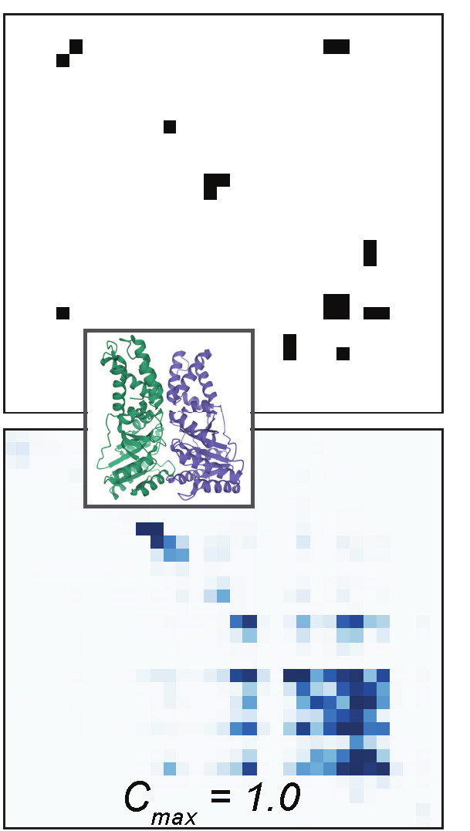
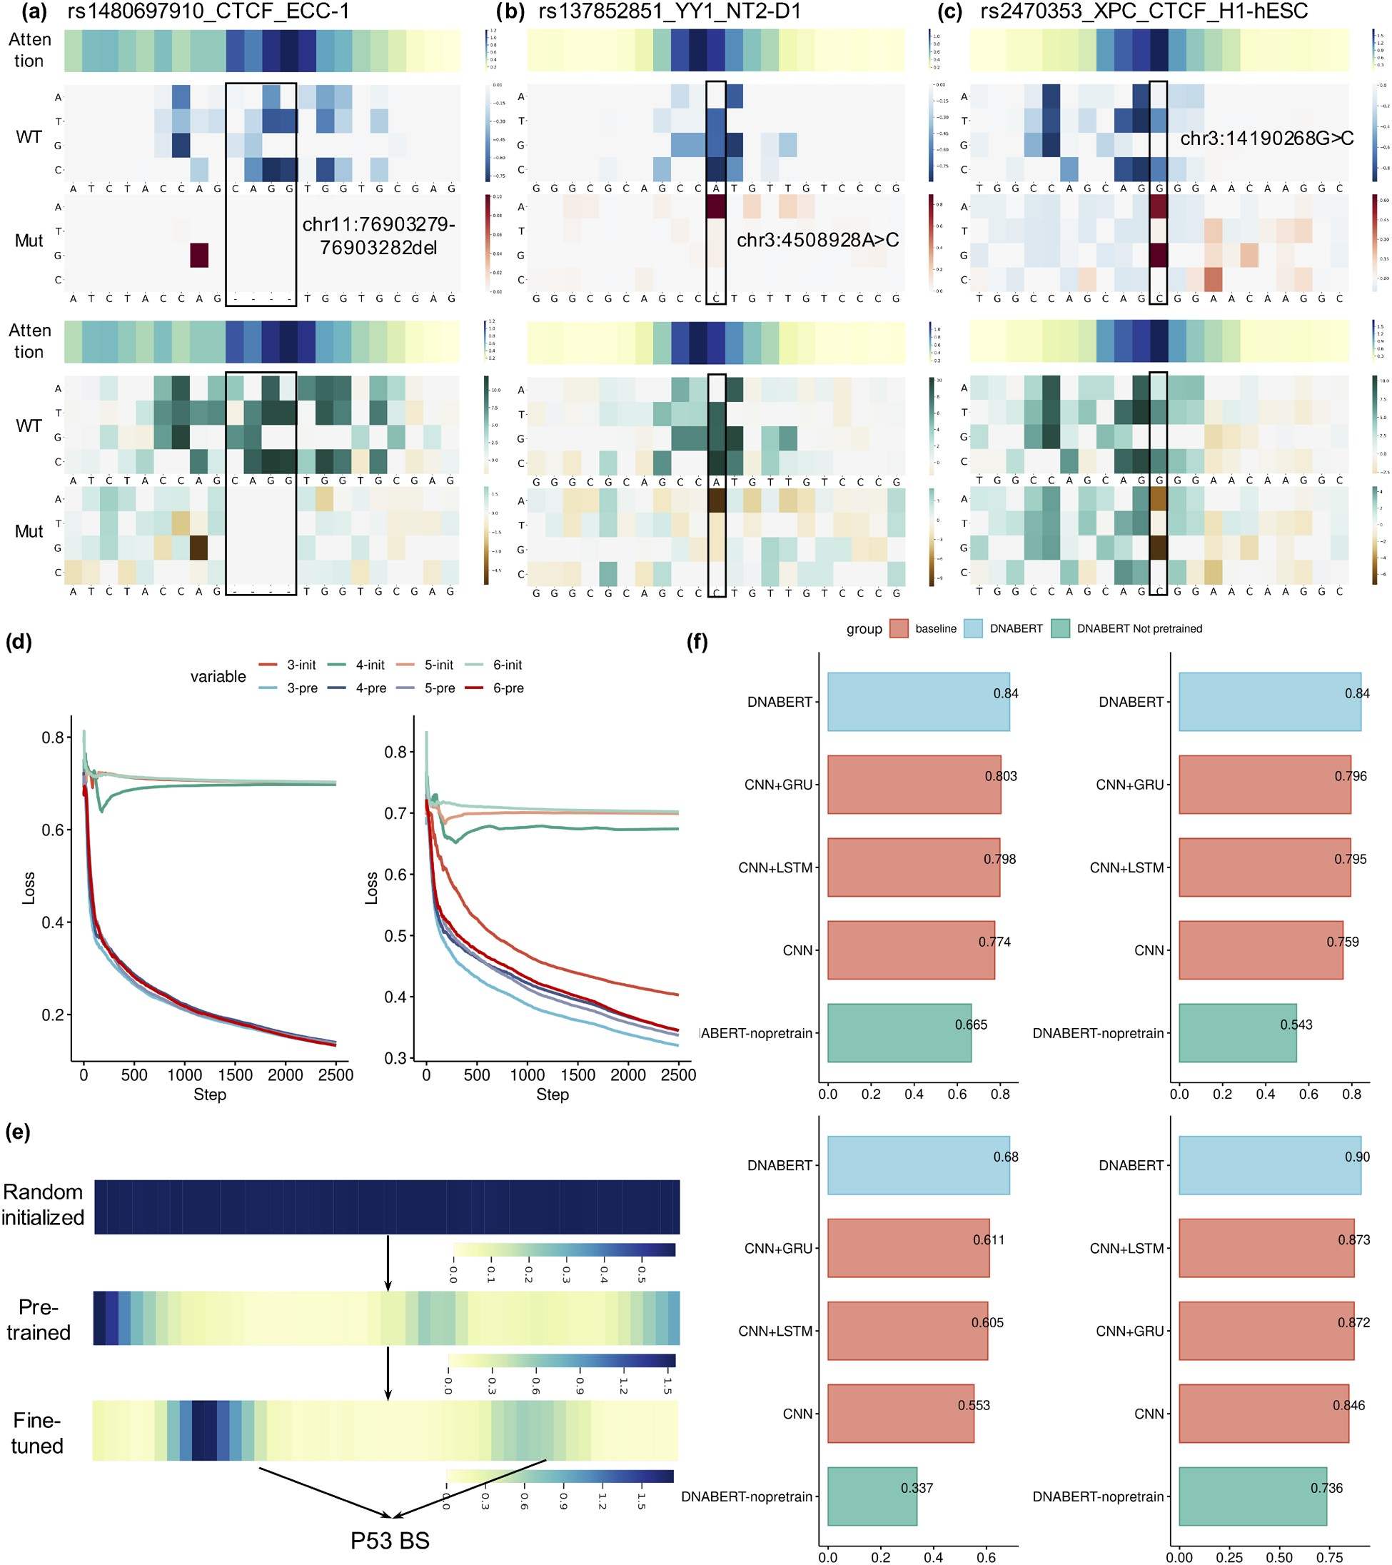
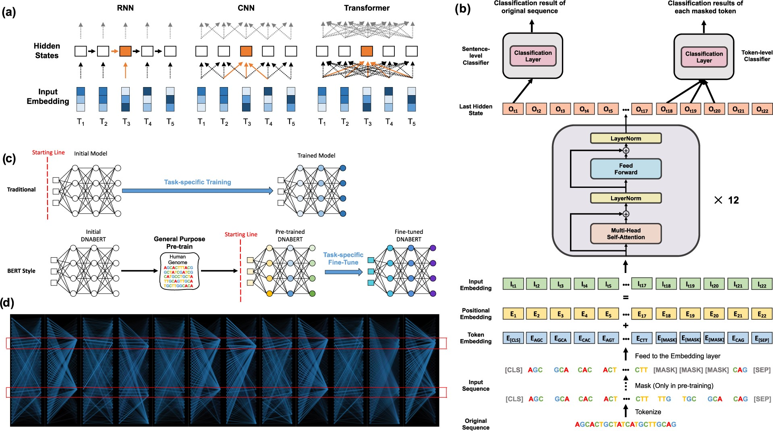
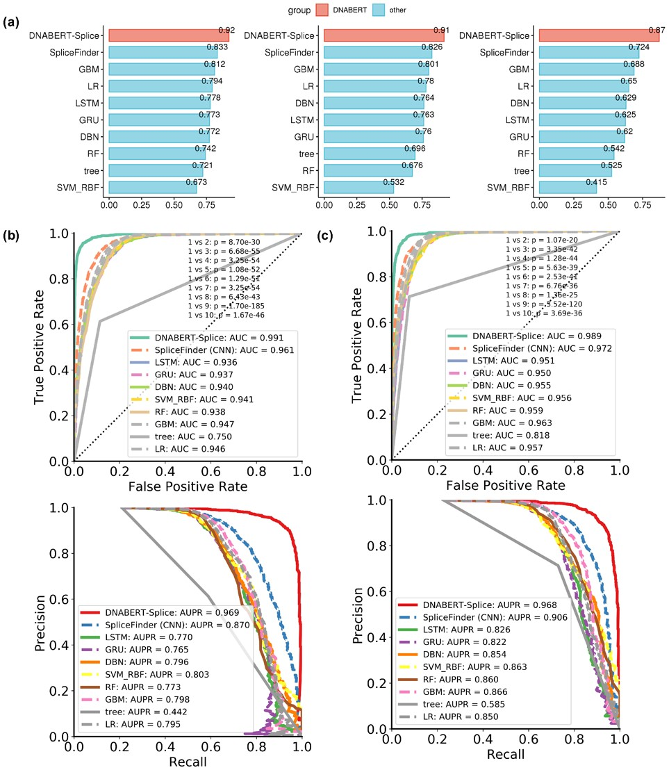
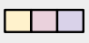
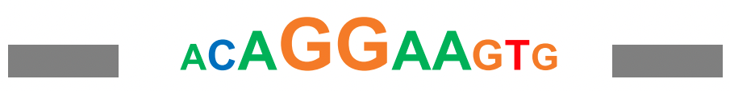
Data pre-processing
Modeling
Interpretation
Search database
Train model
Interaction visualization
Motif discovery
projection module
Protein sequences
ChIP-seq
projection module
Dot-product
Affinities
(m,n,2d)
contact module
Prepare input file
Hyperparameter tuning
Mutational effect
DNA protein label
CTGGCT MEGDAVEAIV 1
GACCTT KLRYTEEGKD 0
Architecture, loss function, embedding dimention, activation functions, model depth, dropout, optimizer…
Load pre-trained embeddings
Model evaluation
CTGGCT
DNABERT
Detect binding sites
More…
MEGDAV
ESM
Notes:
OK, let’s go back to our study design. Roughly there’re three main stages: Data acquisition and pre-processing, model design and training, and the downstream analysis based on prediction
The training data comes from high-throughput assays like ChIP-seq, SELEX, and PBM. We can gather from the main databases, like NCBI GEO, UCSC, ENCODE. And we need the protein sequences, which can be obtained from UniProt. Then we need to process the data into the desired format. The input file will have three entries: DNA sequence, protein sequence and label showing whether DNA and protein have interaction or not. And we’ll split the data into three subsets: training, validation and testing set. Using the pre-training model, we can load the embeddings for DNA sequences and protein sequences separately.
After data pre-processing, we’ll put them into the designed model for training. In this stage, a lot of training experiments are needed to determine the optimal set of hyperparameters to get the best performance. And the model performance will be evaluated by comparing with other similar models
With the trained model, we can derive many biologically meaningful interpretations. For example, DNA-protein contact map is predicted in the middle stage of training, we can compare them with the ground truth. And we can detect binding sites for novel proteins which have no ChIP-seq data. Besides, by aligning the DNA sequences which are predicted to interact with the same protein, novel motifs can be derived. And since our model is sequence-based, we can easily evaluate the mutational effect on the interaction of DNA and protein. And certainly there’re more to explore, like expanding the prediction scope to predicting DNA-protein structure, predicting interaction between RNA and protein, etc…

Slide 8
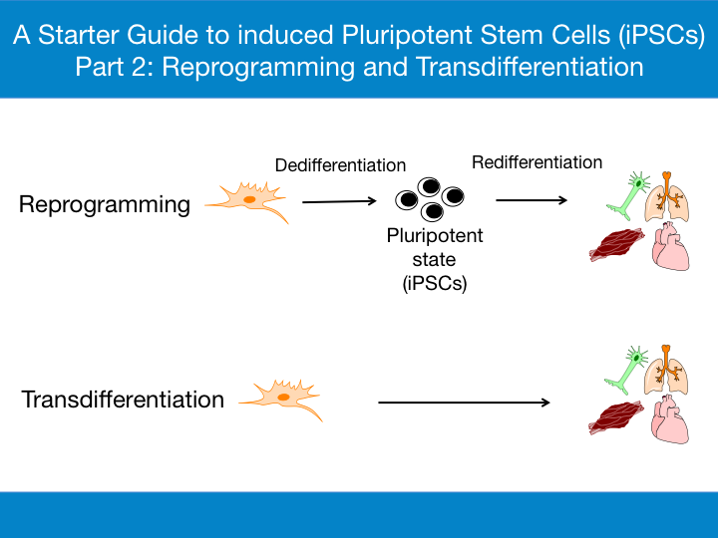
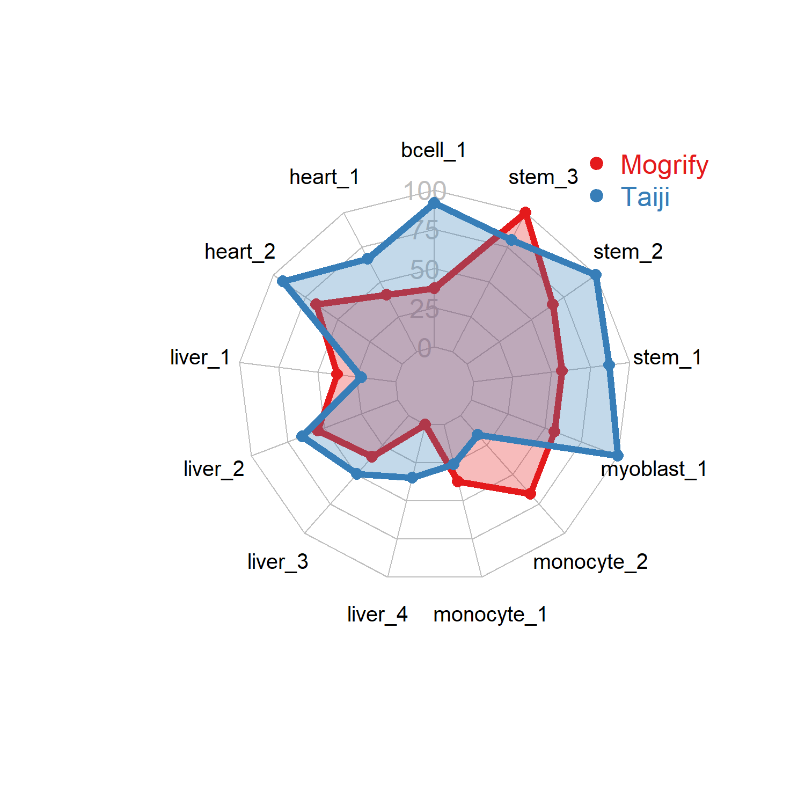
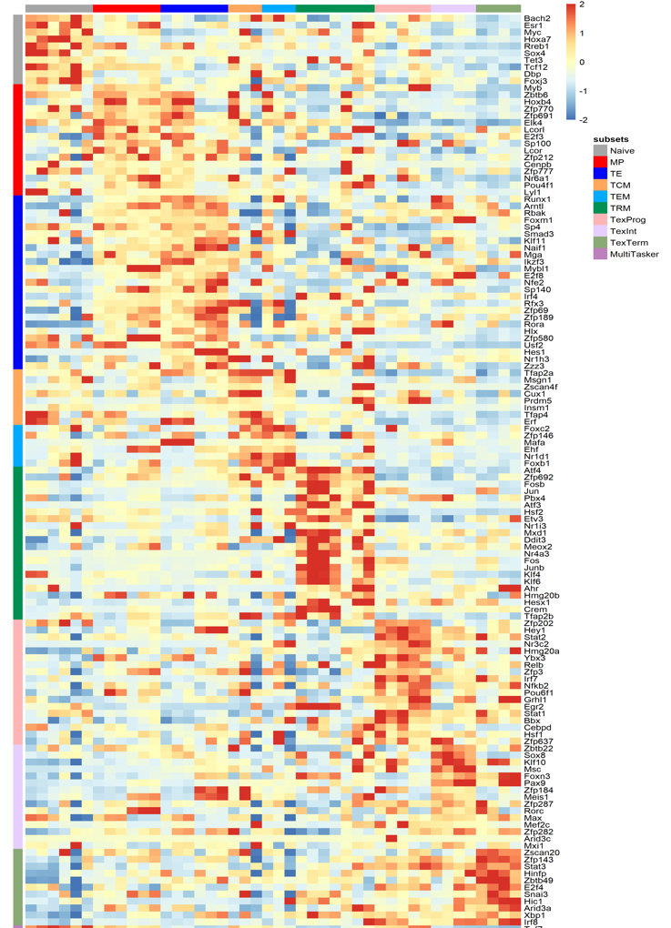
Validate with known reprogramming recipes
Taiji-reprogram
algorithm
Input
Wang et al., NAR. Gen. and Bio. (2021)
Output
TE
TF activity prediction: PageRank score matrix
Rejuvenate exhausted T cells
Acute
infection
T_{CM}
Naive
MP
TE
T_{CM}
T_{EM}
T_{RM}
Tex_{Prog}
Tex_{int}
Tex_{Term}
Prdm1, Bhlhe40, Nfil3, Egr1
Zscan20, Jdp2, Eomes, Batf
MP
T_{EM}
Tex_{Term}
T_{RM}
T_{RM}
Naive
In vivo validation of prediction
PD1 negative
Chronic
infection
Tex_{Eff-like}
T_{EX}Pro
T_{EX}Eff-like
T_{EX}Term
Tex_{Prog}
Tex_{Term}
11 studies, 44 pairs of bulk ATACseq - RNAseq
across 9 cell types
Including ATAC-seq data obtained in this study.
-2 0 2
Notes:
(click) Then, my collaborator Cong run the algorithm called Taiji to calculate the transcription factor activity
by first scan motif binding sites in open chromatin regions
and assign enhaneer and promoters to target. genes (Epitensor prediction) to generate TF to gene target network. Then, assign weight to the network by the mRNA expression and apply filter for the selectivity.
As a result (click) here is the transcription factor activity rank score matrix for each state.
With this prediction, I wanted to perturb terminal exhausted T cell differentiation path to engineer t cells have better cytotoxicity.

Slide 9
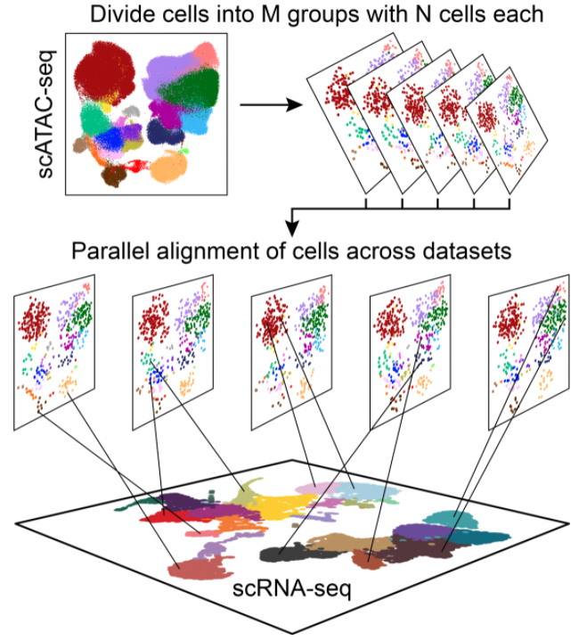
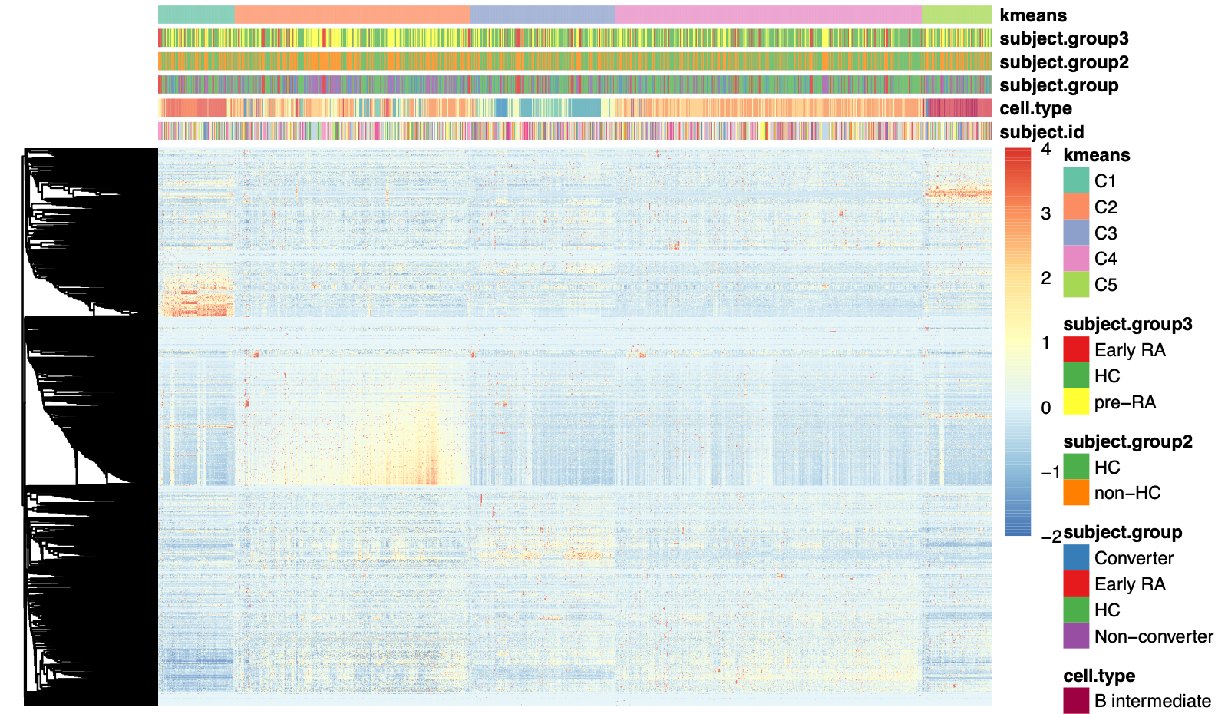
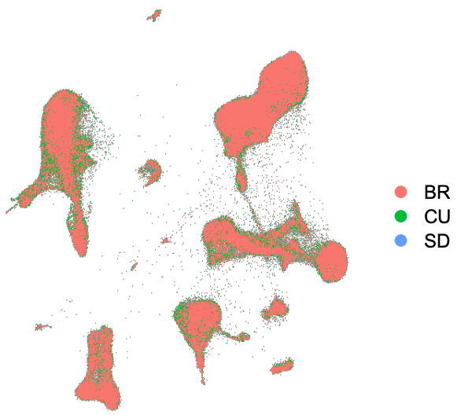
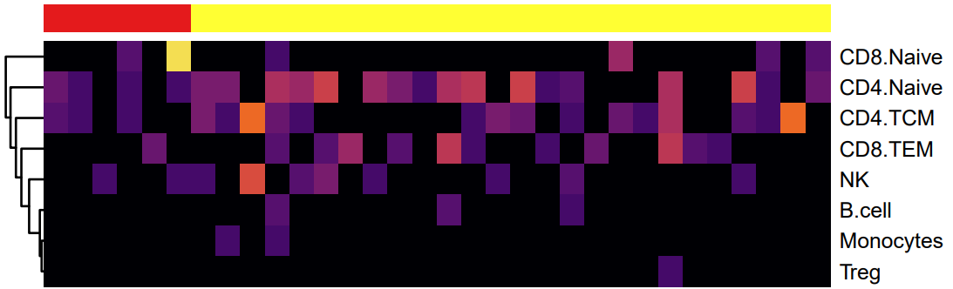
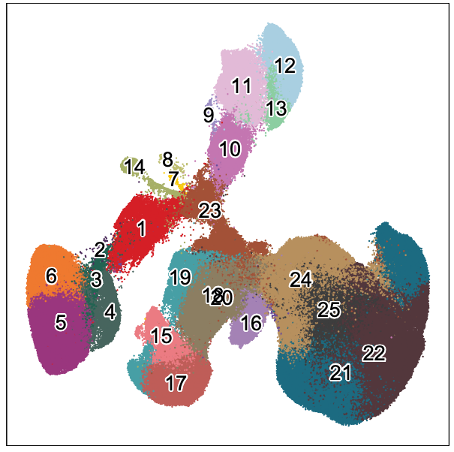
Input
scTaiji
Output
1. Co-embedding
1. Unsupervised clustering shows At-Risk/ERA signature
First-draw matched samples
35 control
26 At-Risk
6 ERA
scATAC-seq
Kmeans group
1. scRNA-seq
Granja et al., Nat. Genet. (2021)
TF activity score
2. Aggregate cells
gene count
cell
2
0
3
1
1
0
0
2
1
2
0
4
0
1
3
2
4
5
3
2. At-Risk/ERA signature across multiple cell lineages
3. Predict TF activity score
ERA
At-Risk
# of clusters
2. scATAC-seq
15
10
5
0

Slide 10
scTaiji-workflow
co-embedding
Aggregate cells:pseudo-bulk
Network construction
Application
TF-specificity
TF-wave
TF-TF network
TF community
Single cell input-multimodal data: scRNA-seq + scATAC-seq
Notes:
scTaiji: most updated Taiji workflow

Slide 11

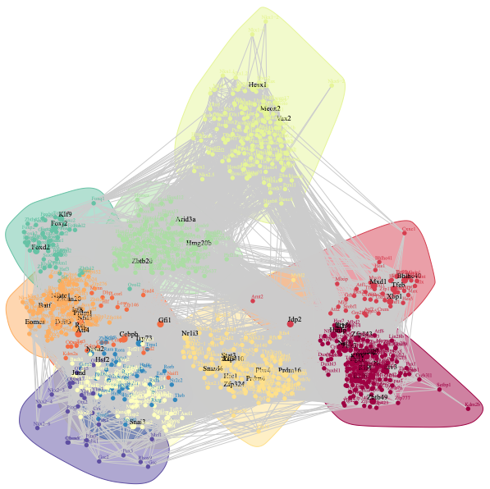
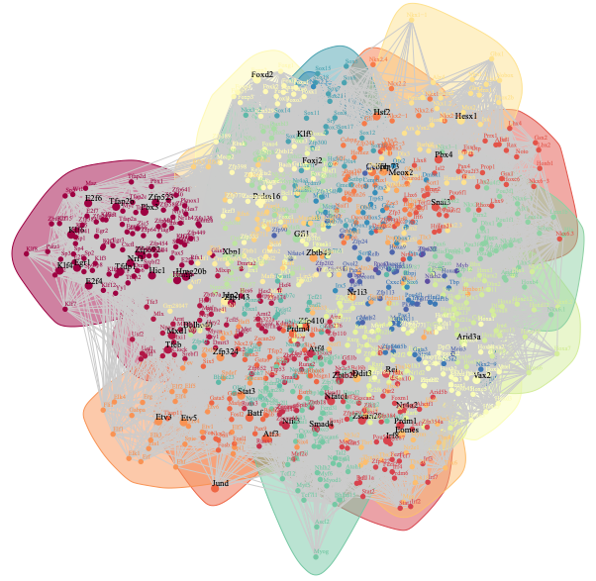
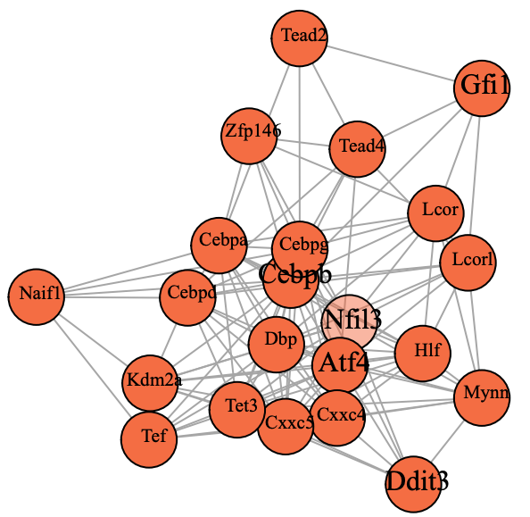
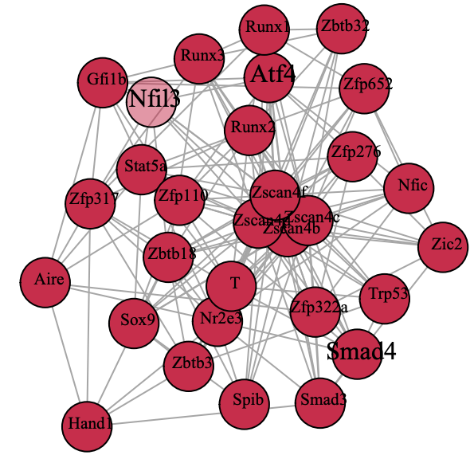

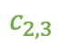

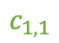

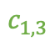

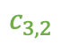

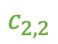

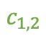
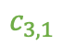

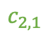

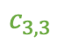
Workflow
Input: TF-regulatee network
TF-TF correlation matrix
Build graphical model
Output: TF-TF interaction network
$$c_{1,1}$$
$$c_{1,2}$$
$$c_{1,3}$$
$$…$$
$$c_{2,1}$$
$$c_{2,2}$$
$$c_{2,3}$$
$$…$$
$$Λ$$
$$c_{3,1}$$
$$c_{3,2}$$
$$c_{3,3}$$
$$…$$
$$…$$
$$…$$
$$…$$
$$…$$
Liu et al., Ann. Stat. (2012)
Example: context dependent role of Nfil3 in Tex and TRM
Tex
TRM
Modularity: 0.5
Modularity: 0.2
Nfil3 involved enriched functional terms in Tex
Rhythmic process
Cellular response to interleukin-4
Nfil3 involved enriched functional terms in TRM
Lymphocyte differentiation
Natural killer cell activation
Cellular response to interleukin-4

